Slide 1

A Project Report On Hospital Management System By K.Govardhani Batch:2021-5889 Under the Guidance of, Mamta Boga Technical Trainer EduBridge (Schoolof Coding)

Slide 2
Introduction: Our project explains about the Hospital Management.This project is user friendly simple, fast, and cost effective. It deals with the collection of patient’s information, diagnosis details, etc. The main function of the system is register and store patient details and doctor details and retrieve these details as and when required. The datacan be retrieved easily. The data are well protected for personal use and makes the data processing very fast. Our Project Include Modules:- • Admin Module • Doctor Module • Paitent Module I have developed this Application in Java, Hibernate and MySQL. It’s a web-based projects so I have used HTML, CSS, JavaScript and . User can search availability of a doctor and the details of a patient using the id . Hospital Management System is designed for multi speciality hospitals, to cover a wide range of hospital administration and management processes. Hospital Management System is powerful, flexible, and easy to use and is designed and developed to deliver real conceivable benefits to hospitals

Slide 3
Software Requirements
Front end: HTML, CSS, JavaScript, Java
Back end: MySQL workbench 8.0.23CE.,Springboot Middleware/
Server: Apache Tomcat v8.5. IDE: Eclipse IDE for Java EE Developers
Browser: Best result on Google Chrome Operating System: Window 10.

Slide 4

Screenshots:- Home Page:

Slide 5
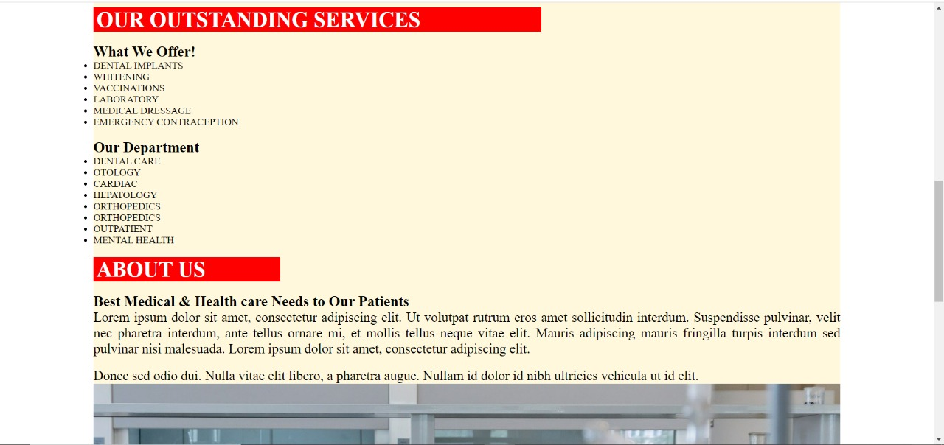
Services and About Us

Slide 6
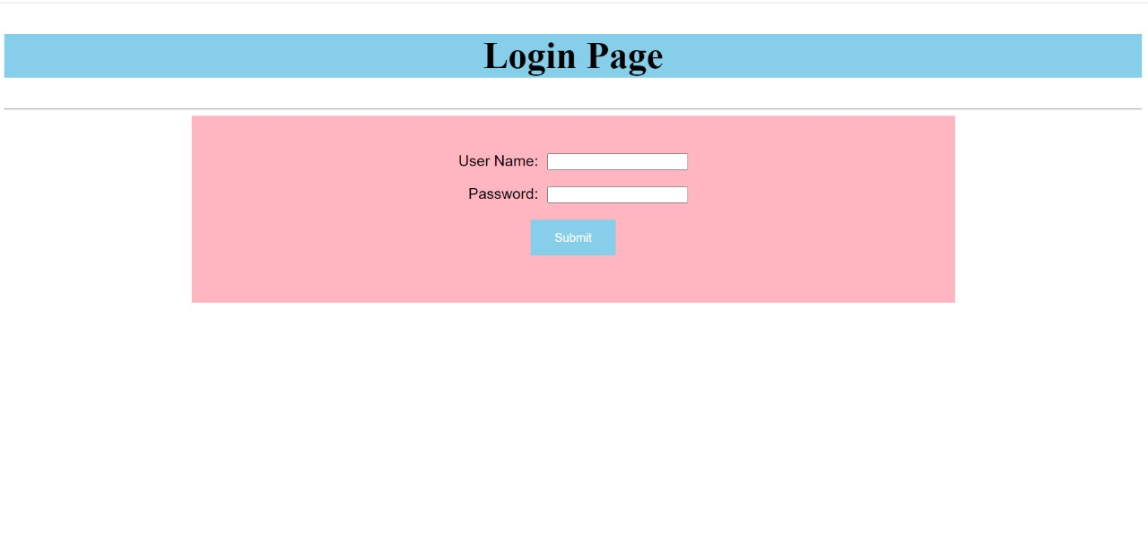
Admin Login Page

Slide 7
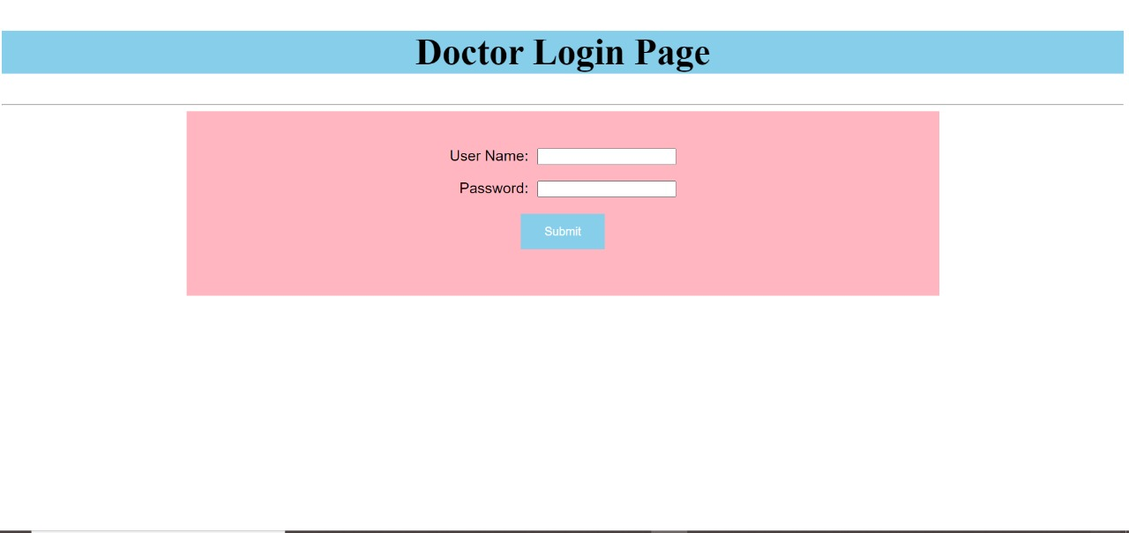
Doctor Login Page

Slide 8
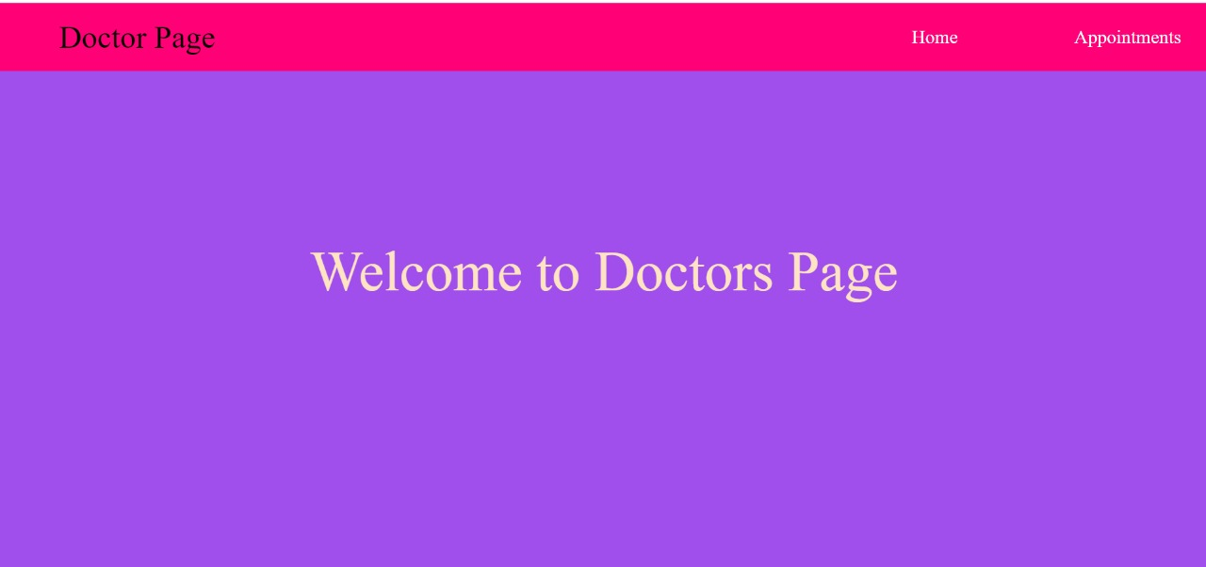
Doctor Page

Slide 9
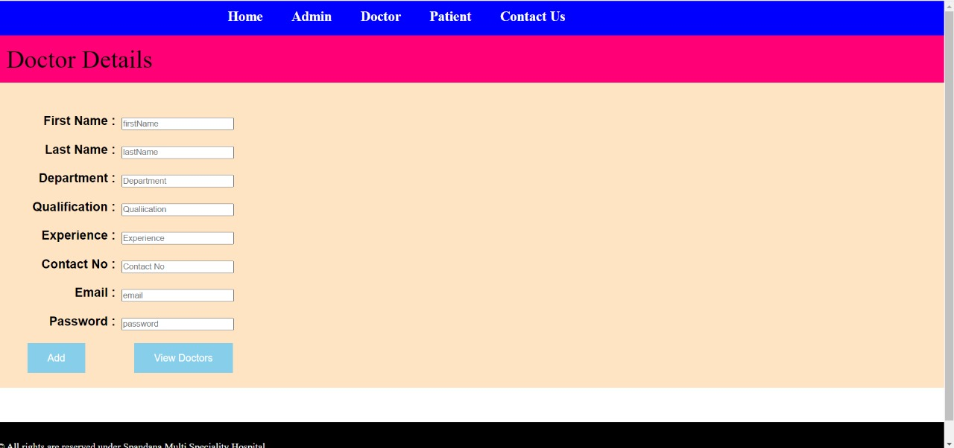
Doctor Details

Slide 10
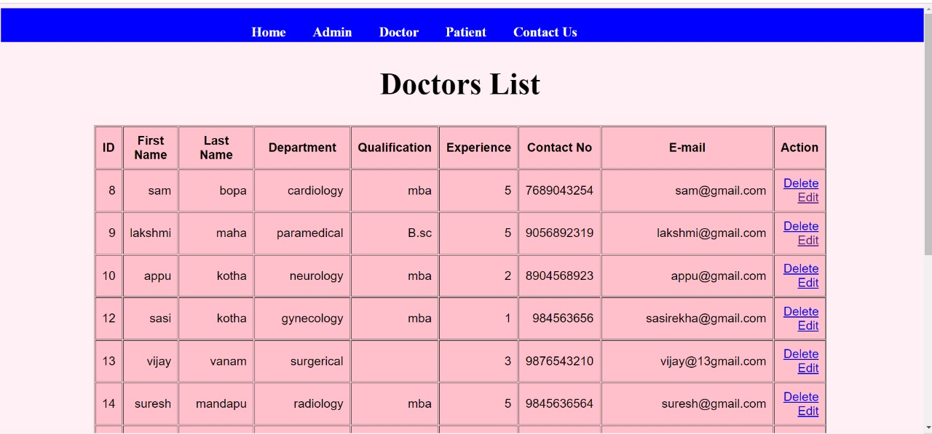
Doctor’s List

Slide 11
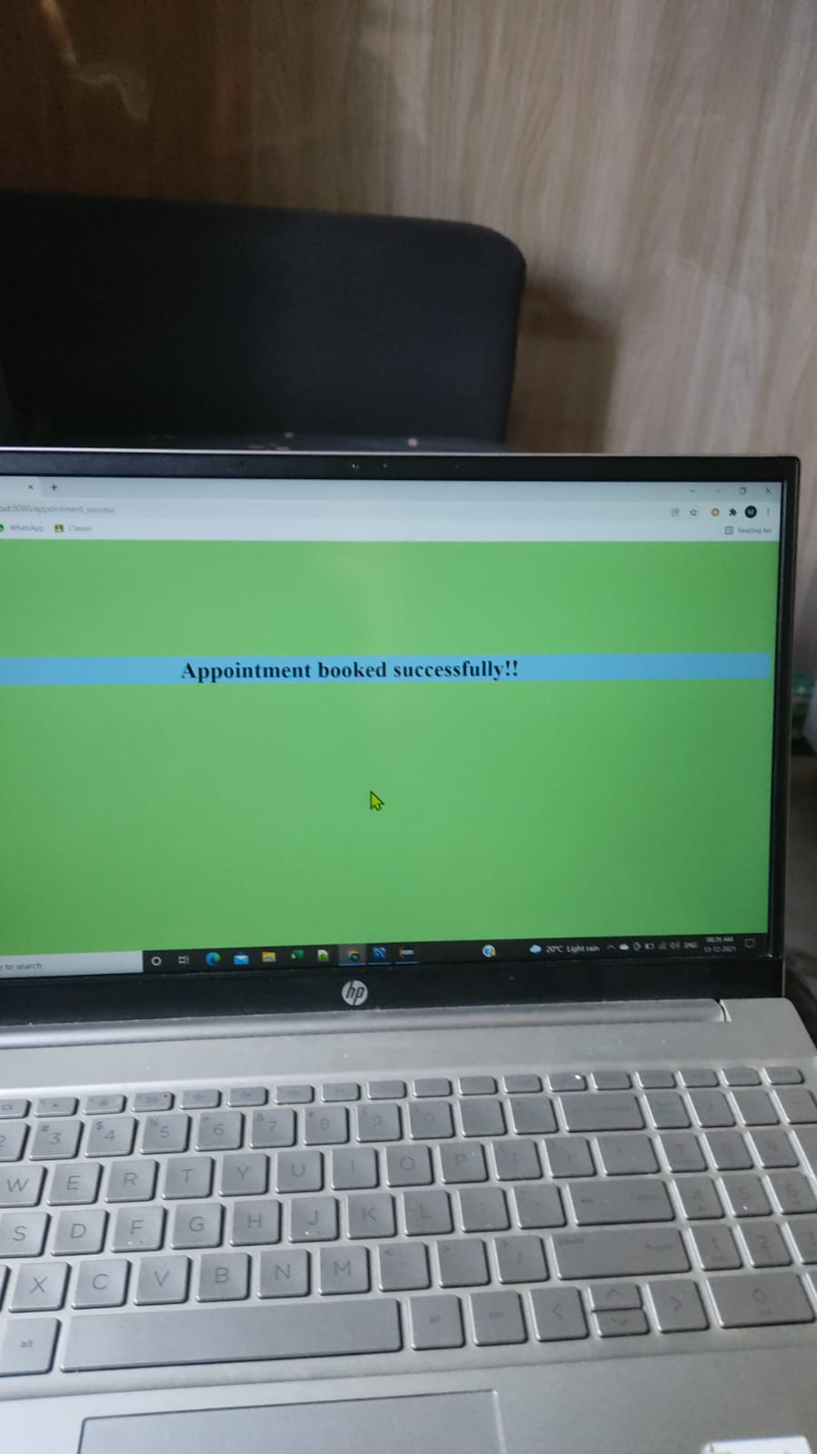
Booking Appointment

Slide 12
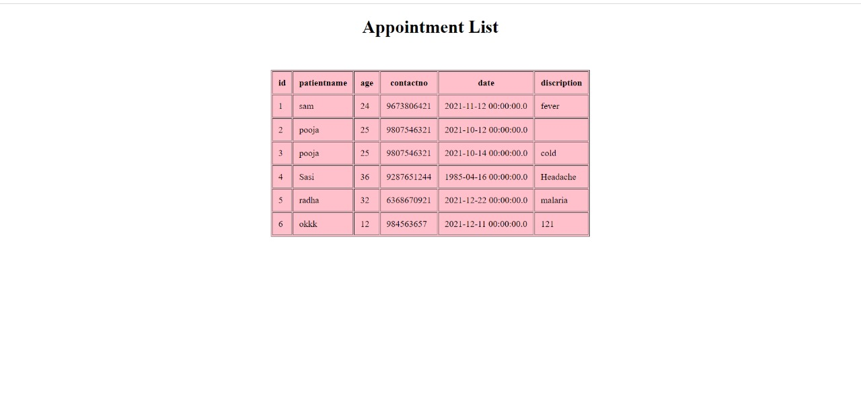
Appointment Page

Slide 13
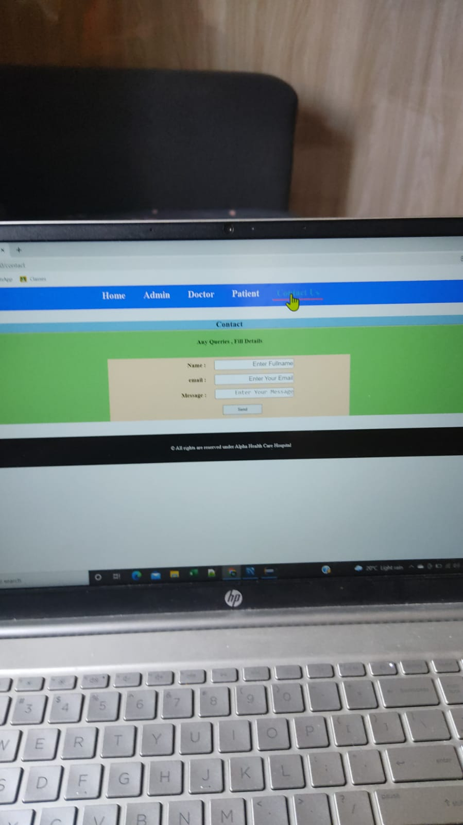
Contact Page

Slide 14


